Slide 1
William Stallings
Data and Computer Communications
Chapter 20
Transport Protocols

Slide 2
Connection Oriented Transport Protocol Mechanisms
Logical connection
Establishment
Maintenance termination
Reliable
e.g. TCP

Slide 3
Reliable Sequencing Network Service
Assume arbitrary length message
Assume virtually 100% reliable delivery by network service
  e.g. reliable packet switched network using X.25
  e.g. frame relay using LAPF control protocol
  e.g. IEEE 802.3 using connection oriented LLC service
Transport service is end to end protocol between two systems on same network

Slide 4
Issues in a Simple Transprot Protocol
Addressing
Multiplexing
Flow Control
Connection establishment and termination

Slide 5
Addressing
Target user specified by:
  User identification
    Usually host, port
      Called a socket in TCP
    Port represents a particular transport service (TS) user
  Transport entity identification
    Generally only one per host
    If more than one, then usually one of each type
      Specify transport protocol (TCP, UDP)
  Host address
    An attached network device
    In an internet, a global internet address
  Network number

Slide 6
Finding Addresses
Four methods
  Know address ahead of time
    e.g. collection of network device stats
  Well known addresses
  Name server
  Sending process request to well known address

Slide 7
Multiplexing
Multiple users employ same transport protocol
User identified by port number or service access point (SAP)
May also multiplex with respect to network services used
  e.g. multiplexing a single virtual X.25 circuit to a number of transport service user
    X.25 charges per virtual circuit connection time

Slide 8
Flow Control
Longer transmission delay between transport entities compared with actual transmission time
  Delay in communication of flow control info
Variable transmission delay
  Difficult to use timeouts
Flow may be controlled because:
  The receiving user can not keep up
  The receiving transport entity can not keep up
Results in buffer filling up

Slide 9
Coping with Flow Control Requirements (1)
Do nothing
  Segments that overflow are discarded
  Sending transport entity will fail to get ACK and will retransmit
    Thus further adding to incoming data
Refuse further segments
  Clumsy
  Multiplexed connections are controlled on aggregate flow

Slide 10
Coping with Flow Control Requirements (2)
Use fixed sliding window protocol
  See chapter 7 for operational details
  Works well on reliable network
    Failure to receive ACK is taken as flow control indication
  Does not work well on unreliable network
    Can not distinguish between lost segment and flow control
Use credit scheme

Slide 11
Credit Scheme
Greater control on reliable network
More effective on unreliable network
Decouples flow control from ACK
  May ACK without granting credit and vice versa
Each octet has sequence number
Each transport segment has seq number, ack number and window size in header

Slide 12
Use of Header Fields
When sending, seq number is that of first octet in segment
ACK includes AN=i, W=j
All octets through SN=i-1 acknowledged
  Next expected octet is i
Permission to send additional window of W=j octets
  i.e. octets through i+j-1

Slide 13
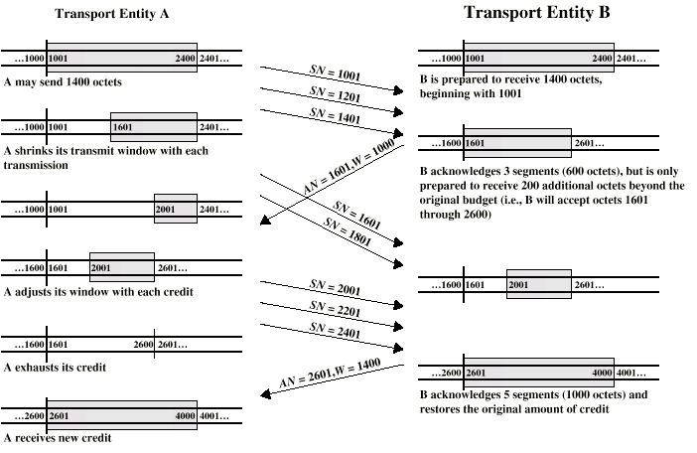
Credit Allocation

Slide 14
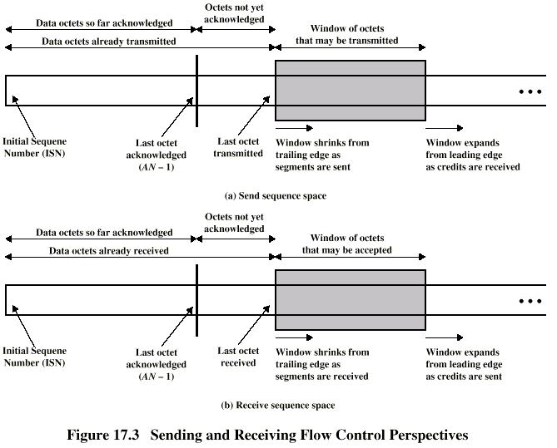
Sending and Receiving Perspectives

Slide 15
Establishment and Termination
Allow each end to now the other exists
Negotiation of optional parameters
Triggers allocation of transport entity resources
By mutual agreement

Slide 16
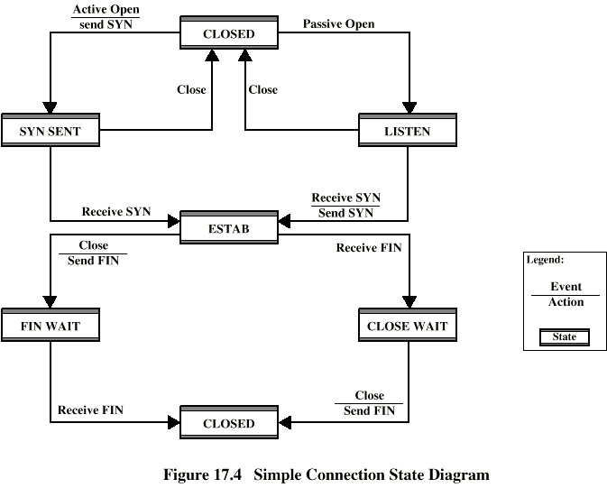
Connection State Diagram

Slide 17
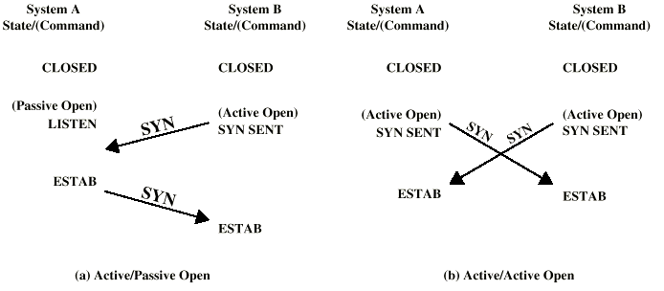
Connection Establishment

Slide 18
Not Listening
Reject with RST (Reset)
Queue request until matching open issued
Signal TS user to notify of pending request
  May replace passive open with accept

Slide 19
Termination
Either or both sides
By mutual agreement
Abrupt termination
Or graceful termination
  Close wait state must accept incoming data until FIN received

Slide 20
Side Initiating Termination
TS user Close request
Transport entity sends FIN, requesting termination
Connection placed in FIN WAIT state
  Continue to accept data and deliver data to user
  Not send any more data
When FIN received, inform user and close connection

Slide 21
Side Not Initiating Termination
FIN received
Inform TS user Place connection in CLOSE WAIT state
  Continue to accept data from TS user and transmit it
TS user issues CLOSE primitive
Transport entity sends FIN
Connection closed
All outstanding data is transmitted from both sides
Both sides agree to terminate

Slide 22
Unreliable Network Service
E.g.
  internet using IP,
  frame relay using LAPF
  IEEE 802.3 using unacknowledged connectionless LLC
Segments may get lost
Segments may arrive out of order

Slide 23
Problems
Ordered Delivery
Retransmission strategy
Duplication detection
Flow control
Connection establishment
Connection termination
Crash recovery

Slide 24
Ordered Delivery
Segments may arrive out of order
Number segments sequentially
TCP numbers each octet sequentially
Segments are numbered by the first octet number in the segment

Slide 25
Retransmission Strategy
Segment damaged in transit
Segment fails to arrive
Transmitter does not know of failure
Receiver must acknowledge successful receipt
Use cumulative acknowledgement
Time out waiting for ACK triggers
re-transmission

Slide 26
Timer Value
Fixed timer
  Based on understanding of network behavior
  Can not adapt to changing network conditions
  Too small leads to unnecessary re-transmissions
  Too large and response to lost segments is slow
  Should be a bit longer than round trip time
Adaptive scheme
  May not ACK immediately
  Can not distinguish between ACK of original segment and re-transmitted segment
  Conditions may change suddenly

Slide 27
Duplication Detection
If ACK lost, segment is re-transmitted
Receiver must recognize duplicates
Duplicate received prior to closing connection
  Receiver assumes ACK lost and ACKs duplicate
  Sender must not get confused with multiple ACKs
  Sequence number space large enough to not cycle within maximum life of segment
Duplicate received after closing connection

Slide 28
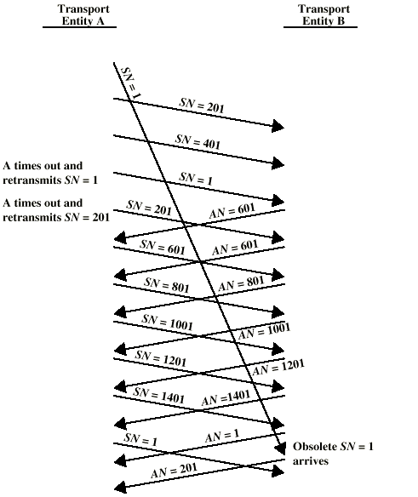
Incorrect
Duplicate
Detection

Slide 29
Flow Control
Credit allocation
Problem if AN=i, W=0 closing window
Send AN=i, W=j to reopen, but this is lost
Sender thinks window is closed, receiver thinks it is open
Use window timer
If timer expires, send something
  Could be re-transmission of previous segment

Slide 30
Connection Establishment
Two way handshake
  A send SYN, B replies with SYN
  Lost SYN handled by re-transmission
    Can lead to duplicate SYNs
  Ignore duplicate SYNs once connected
Lost or delayed data segments can cause connection problems
  Segment from old connections
  Start segment numbers fare removed from previous connection
    Use SYN i
    Need ACK to include i
    Three Way Handshake

Slide 31
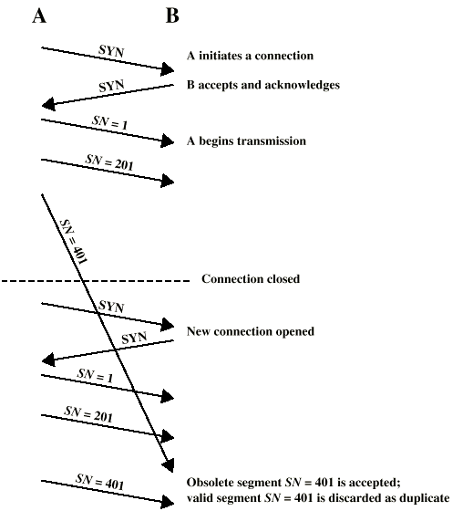
Two Way
Handshake:
Obsolete
Data
Segment

Slide 32
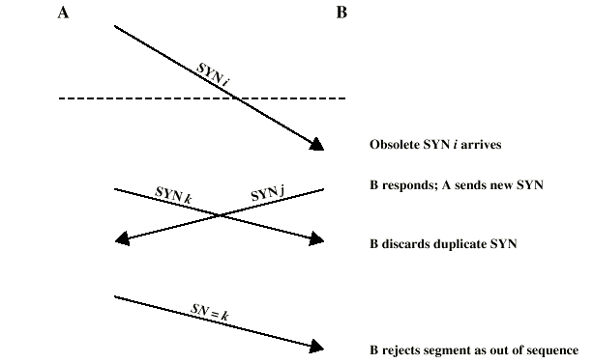
Two Way Handshake:
Obsolete SYN Segment

Slide 33
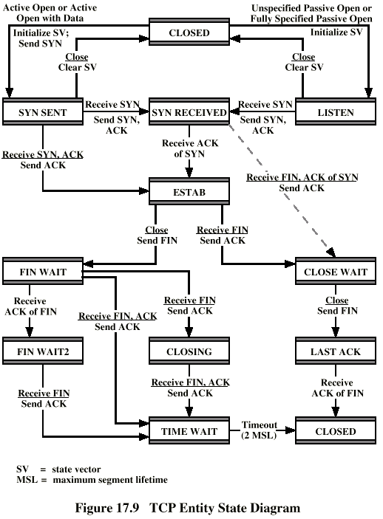
Three Way
Handshake:
State
Diagram

Slide 34
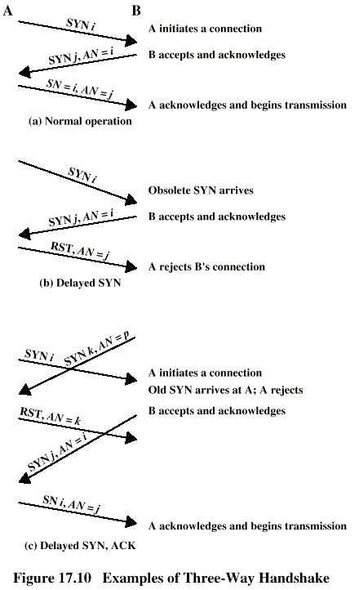
Three Way
Handshake:
Examples

Slide 35
Connection Termination
Entity in CLOSE WAIT state sends last data segment, followed by FIN
FIN arrives before last data segment
Receiver accepts FIN
  Closes connection
  Loses last data segment
Associate sequence number with FIN
Receiver waits for all segments before FIN sequence number
Loss of segments and obsolete segments
  Must explicitly ACK FIN

Slide 36
Graceful Close
Send FIN i and receive AN i
Receive FIN j and send AN j
Wait twice maximum expected segment lifetime

Slide 37
Failure Recovery
After restart all state info is lost
Connection is half open
  Side that did not crash still thinks it is connected
Close connection using persistence timer
  Wait for ACK for (time out) * (number of retries)
  When expired, close connection and inform user
Send RST i in response to any i segment arriving
User must decide whether to reconnect
  Problems with lost or duplicate data

Slide 38
TCP & UDP
Transmission Control Protocol
  Connection oriented
  RFC 793
User Datagram Protocol (UDP)
  Connectionless
  RFC 768

Slide 39
TCP Services
Reliable communication between pairs of processes
Across variety of reliable and unreliable networks and internets
Two labeling facilities
  Data stream push
    TCP user can require transmission of all data up to push flag
    Receiver will deliver in same manner
    Avoids waiting for full buffers
  Urgent data signal
    Indicates urgent data is upcoming in stream
    User decides how to handle it

Slide 40
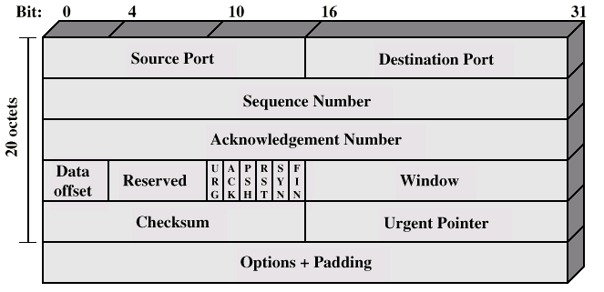
TCP Header

Slide 41
Items Passed to IP
TCP passes some parameters down to IP
  Precedence
  Normal delay/low delay
  Normal throughput/high throughput
  Normal reliability/high reliability
  Security

Slide 42
TCP Mechanisms (1)
Connection establishment
  Three way handshake
  Between pairs of ports
  One port can connect to multiple destinations

Slide 43
TCP Mechanisms (2)
Data transfer
  Logical stream of octets
  Octets numbered modulo 2²³
  Flow control by credit allocation of number of octets
  Data buffered at transmitter and receiver

Slide 44
TCP Mechanisms (3)
Connection termination
  Graceful close
  TCP users issues CLOSE primitive
  Transport entity sets FIN flag on last segment sent
  Abrupt termination by ABORT primitive
    Entity abandons all attempts to send or receive data
    RST segment transmitted

Slide 45
Implementation Policy Options
Send
Deliver
Accept
Retransmit
Acknowledge

Slide 46
Send
If no push or close TCP entity transmits at its own convenience
Data buffered at transmit buffer
May construct segment per data batch
May wait for certain amount of data

Slide 47
Deliver
In absence of push, deliver data at own convenience
May deliver as each in order segment received
May buffer data from more than one segment

Slide 48
Accept
Segments may arrive out of order
In order
  Only accept segments in order
  Discard out of order segments
In windows
  Accept all segments within receive window

Slide 49
Retransmit
TCP maintains queue of segments transmitted but not acknowledged
TCP will retransmit if not ACKed in given time
  First only
  Batch
  Individual

Slide 50
Acknowledgement
Immediate
Cumulative

Slide 51
Congestion Control
RFC 1122, Requirements for Internet hosts
Retransmission timer management
  Estimate round trip delay by observing pattern of delay
  Set time to value somewhat greater than estimate
  Simple average
  Exponential average
  RTT Variance Estimation (Jacobson’s algorithm)

Slide 52
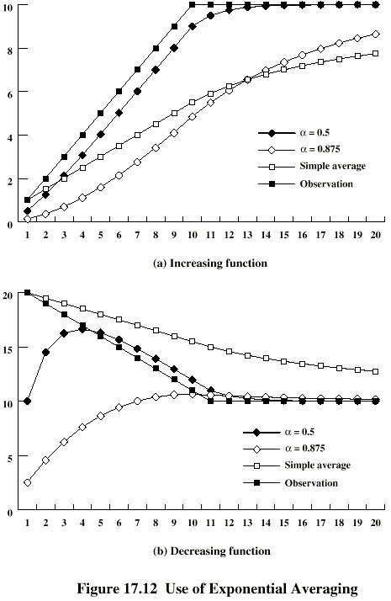
Use of
Exponential
Averaging

Slide 53
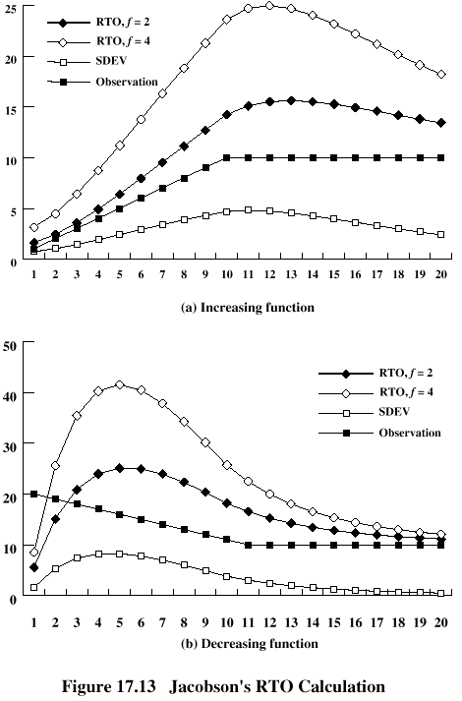
Jacobson’s
RTO
Calculation

Slide 54
Exponential RTO Backoff
Since timeout is probably due to congestion (dropped packet or long round trip), maintaining RTO is not good idea
RTO increased each time a segment is
re-transmitted
RTO = q*RTO
Commonly q=2
  Binary exponential backoff

Slide 55
Karn’s Algorithm
If a segment is re-transmitted, the ACK arriving may be:
  For the first copy of the segment
    RTT longer than expected
  For second copy
No way to tell
Do not measure RTT for re-transmitted segments
Calculate backoff when re-transmission occurs
Use backoff RTO until ACK arrives for segment that has not been re-transmitted

Slide 56
Window Management
Slow start
  awnd = MIN[credit, cwnd]
  Start connection with cwnd=1
  Increment cwnd at each ACK, to some max
Dynamic windows sizing on congestion
  When a timeout occurs
  Set slow start threshold to half current congestion window
    ssthresh=cwnd/2
  Set cwnd = 1 and slow start until cwnd=ssthresh
    Increasing cwnd by 1 for every ACK
  For cwnd >=ssthresh, increase cwnd by 1 for each RTT

Slide 57
UDP
User datagram protocol
RFC 768
Connectionless service for application level procedures
  Unreliable
  Delivery and duplication control not guaranteed
Reduced overhead
e.g. network management (Chapter 19)

Slide 58
UDP Uses
Inward data collection
Outward data dissemination
Request-Response
Real time application

Slide 59
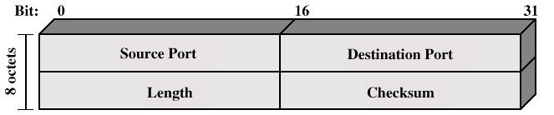
UDP Header

Slide 60
Required Reading
Stallings chapter 20
RFCs

